Slide 1
DESN2000 Week 1
Design sprint
Design Next, workshop 1

Slide 2
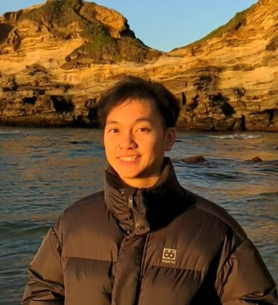
Meet your demonstrator
My name is Dan Nguyen
Mechatronics / Computer Science (6th year 😭)
Did SLPs for 2 years and a lot of project management related stuff
Favourite hobbies: Taekwondo 🥋 and climbing 🧗‍♀️
Intro | Read the brief | Group formation | Define problem | Empathise | Reframe | Ideate | Prep pitch | Present
5 min | 5 min | 10 min | 5 min | 15 min | 5 min | 10 min | 5 min | 10 min
all | individual | all | group | group | group | group | group | all
Notes:
On a side note, I will not be here in week 3 because of unigames

Slide 3
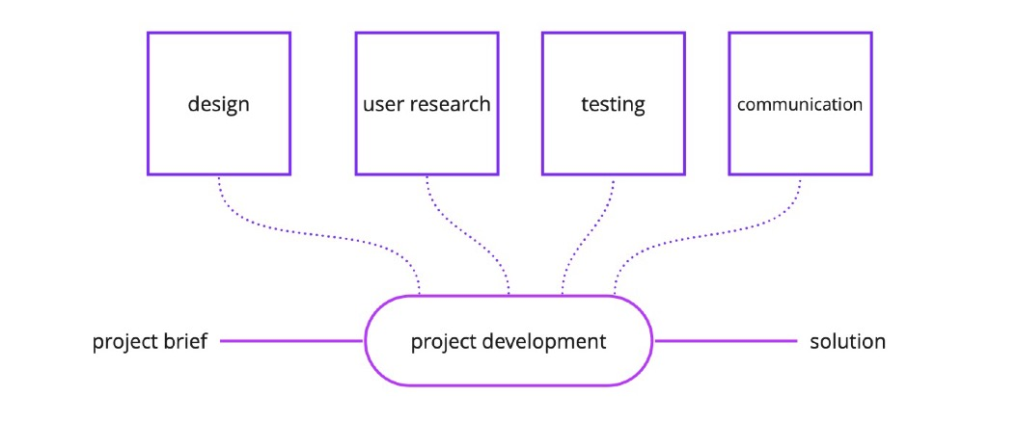
Housekeeping
Expectations from workshops
Feed your project development with tools and methods useful to manage the complexity of the design process.
Intro | Read the brief | Group formation | Define problem | Empathise | Reframe | Ideate | Prep pitch | Present
5 min | 5 min | 10 min | 5 min | 15 min | 5 min | 10 min | 5 min | 10 min
all | individual | all | group | group | group | group | group | all
Notes:
Hold hands during the design process

Slide 4
Housekeeping
Expectations from workshops
Outcomes: meaningful progress on project deliverables, improving skills
Guided workshops to deliver part of your project
Skill-oriented workshops to practice with a particular skill
Mentor-style workshops for groups to work on project with guidance
Attendance: students are expected to attend all workshops.
Participation: participation in class activities is strongly encouraged so students can practically engage in group work and communication
Respect: students are encouraged and expected to respect both the demonstrator and their peers by actively listening to the demonstrator or peers and not being distracted by other work during the workshop time.
Intro | Read the brief | Group formation | Define problem | Empathise | Reframe | Ideate | Prep pitch | Present
5 min | 5 min | 10 min | 5 min | 15 min | 5 min | 10 min | 5 min | 10 min
all | individual | all | group | group | group | group | group | all
Notes:
Basically, I am your mentor to guide your project. Give advice/suggestions and show when/how to use tools/methods. But I won’t make the final decision for you.
You will need to use these workshops to work on your projects so attendance is basically “mandatory”.

Slide 5
Housekeeping
Online Communication
MS Teams private message for personal/individual enquiries
Talk in the Workshop – T14A channel for general questions related to the labs
We will also use this channel to upload docs used for the workshop
Ask questions in the Forum for course related stuff
Intro | Read the brief | Group formation | Define problem | Empathise | Reframe | Ideate | Prep pitch | Present
5 min | 5 min | 10 min | 5 min | 15 min | 5 min | 10 min | 5 min | 10 min
all | individual | all | group | group | group | group | group | all

Slide 6
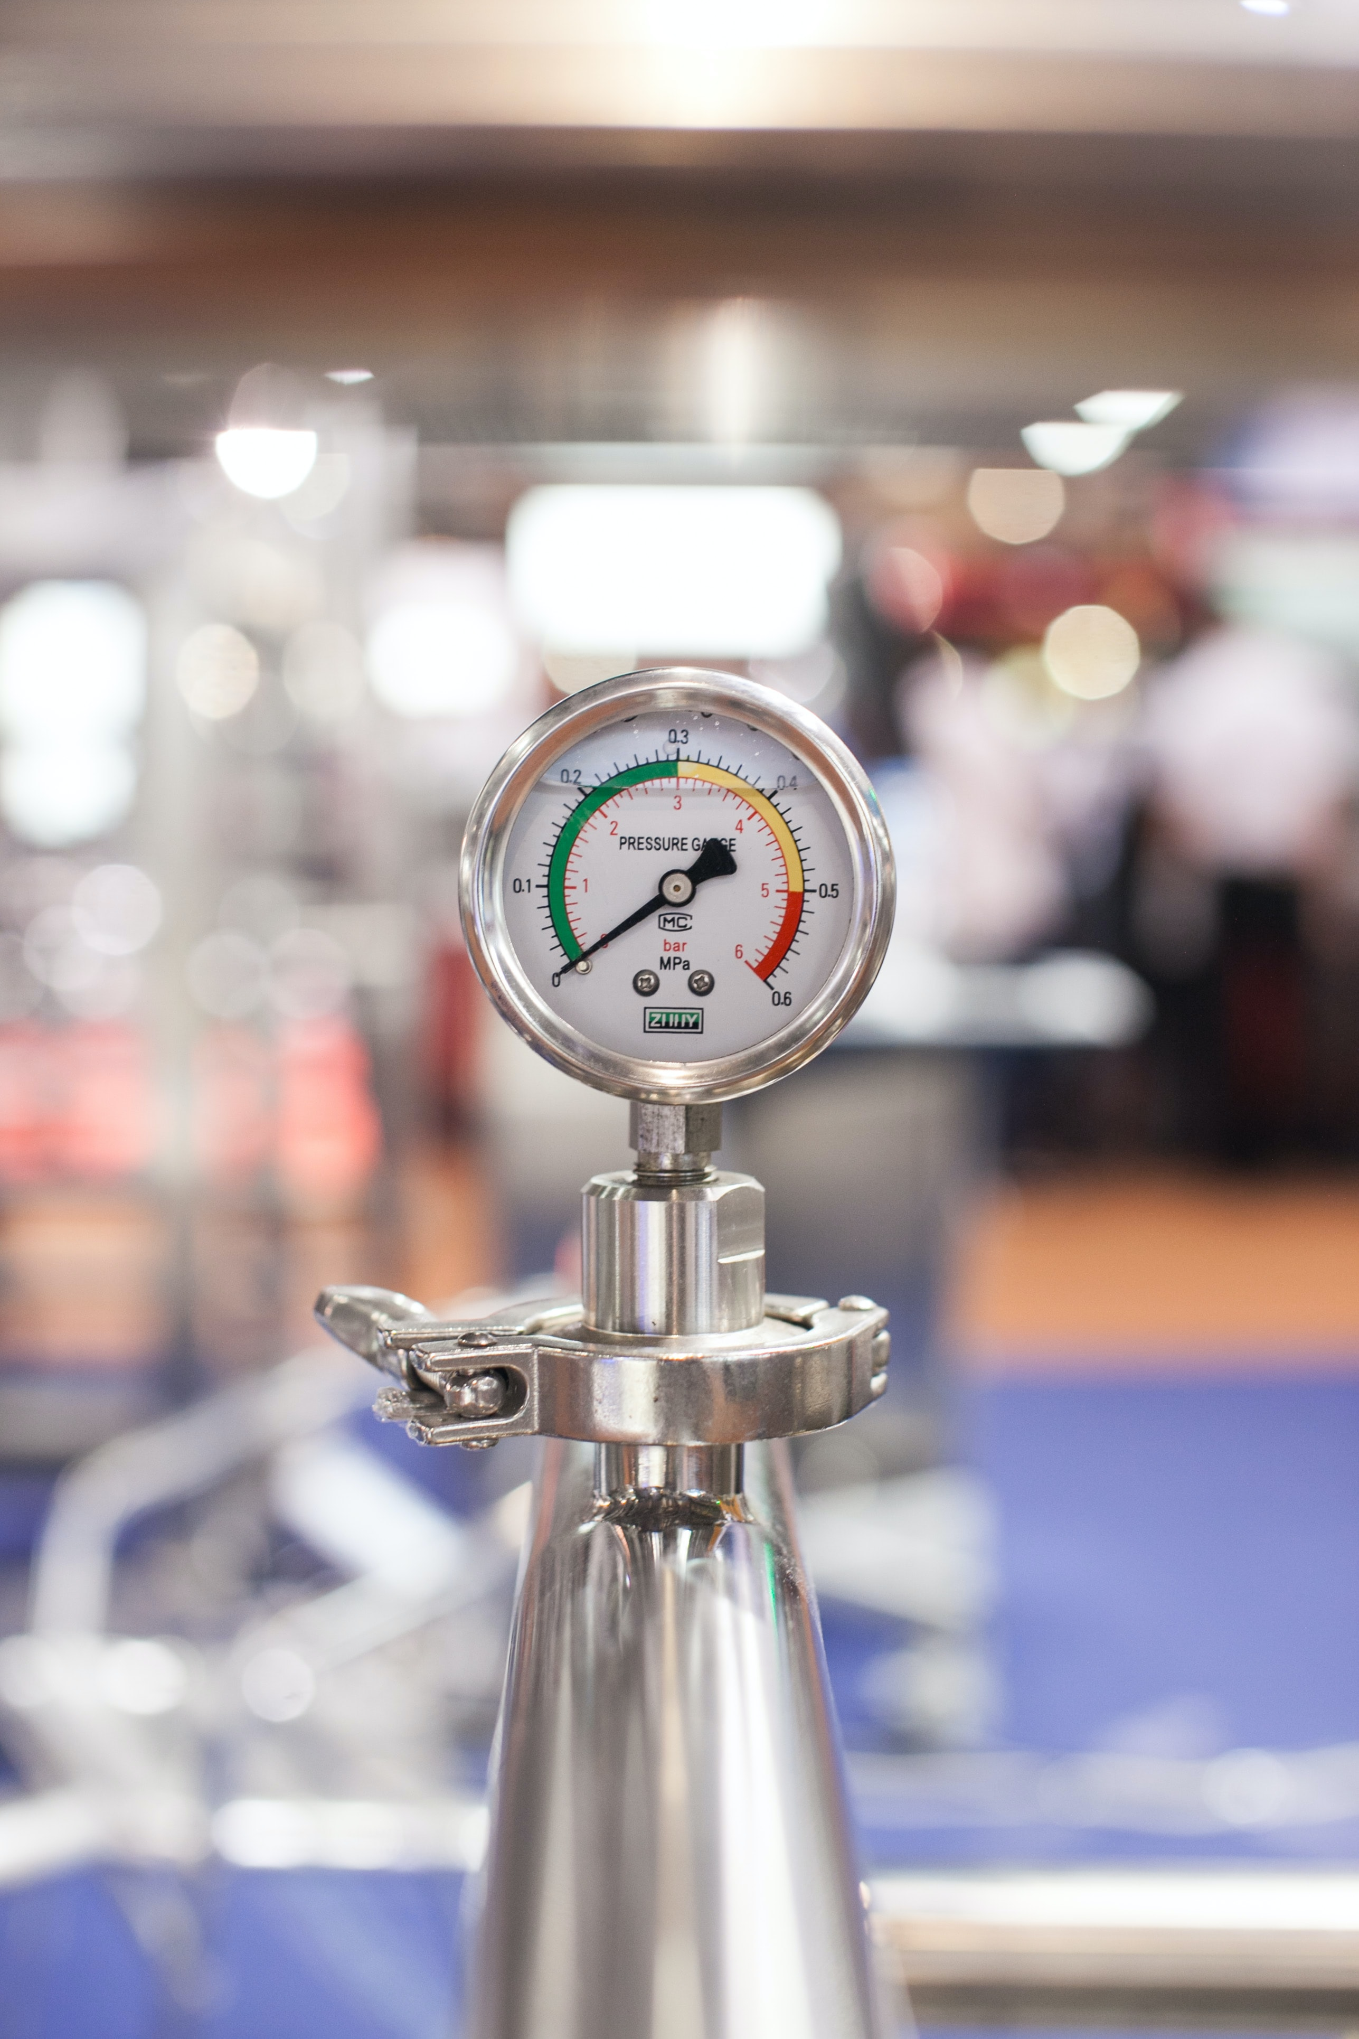
Today: pressure cooker
We’re not going to cook :(
We’re just going to run through the project
… but in a very compressed time!
Mistakes and jumping to conclusions is fine!
The point is to go through the process, not be perfect
Intro | Read the brief | Group formation | Define problem | Empathise | Reframe | Ideate | Prep pitch | Present
5 min | 5 min | 10 min | 5 min | 15 min | 5 min | 10 min | 5 min | 10 min
all | individual | all | group | group | group | group | group | all
https://unsplash.com/photos/9XsXOdkdxPQ
Notes:
Today’s workshop is to go through all the steps for how you would do the project. Basically, project condensed.
Skim through the brief + form groups –simultaneously.
Pick any problem – can be generic, doesn’t have to be your final one.

Slide 7
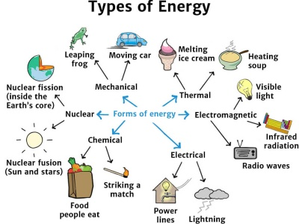

1. Read (again) the project brief
Find brief on Moodle or in our Teams channel.
Basically, a MECH/MTRN energy harvesting device with a user-centred problem.
E.g. Energy is being lost in some form and some users could benefit or have pain points…
Intro | Read the brief | Group formation | Define problem | Empathise | Reframe | Ideate | Prep pitch | Present
5 min | 5 min | 10 min | 5 min | 15 min | 5 min | 10 min | 5 min | 10 min
all | individual | all | group | group | group | group | group | all
Notes:
Only need to skim through it. We will go through the brief in more detail tomorrow.

Slide 8
2. Group formation (if not complete yet)
Groups of ~6 people for the whole term
Members must be all from the same workshop class
Everyone in the group, give your names and zID to your demonstrator ON OUR TEAMS CHANNEL
These group formation instructions are superseded by any instructions provided by your Project Coordinator or Demonstrator
Intro | Read the brief | Group formation | Define problem | Empathise | Reframe | Ideate | Prep pitch | Present
5 min | 5 min | 10 min | 5 min | 15 min | 5 min | 10 min | 5 min | 10 min
all | individual | all | group | group | group | group | group | all
Notes:
Use the excel to keep track of groups. Although groups won’t be official until the Moodle group formation tool is opened after census date
Just get students to message the Teams channel for their names and zID.

Slide 9
3. Define problem
Make sure the team has something to write on; paper or whiteboard
Strongly recommend Miro (and to use this for every single workshop and the project)
Define your technical problem based on your project brief
Make a short list of the people who are involved in the challenge laid out in the brief
No need to think for long; you can/have to do more research later and change away from the user you’re focusing on today
Intro | Read the brief | Group formation | Define problem | Empathise | Reframe | Ideate | Prep pitch | Present
5 min | 5 min | 10 min | 5 min | 15 min | 5 min | 10 min | 5 min | 10 min
all | individual | all | group | group | group | group | group | all
Notes:
Feel free to use ChatGPT to generate ideas.

Slide 10
4. Empathise with your user (1/2)
Map out characteristics for 2x potential users
You’ll have to make assumptions here; your aim is to quickly sketch two profiles
Spend max 10 minutes on this
Time is short; divide and conquer?
Sample things to put onto a mind map:
What they like?
What are their interests in the problem?
Their aims in life?
What are they good at? What can’t they do?
What other things do they do while interacting with the project brief problem?
Intro | Read the brief | Group formation | Define problem | Empathise | Reframe | Ideate | Prep pitch | Present
5 min | 5 min | 10 min | 5 min | 15 min | 5 min | 10 min | 5 min | 10 min
all | individual | all | group | group | group | group | group | all

Slide 11
4. Empathise with your user (2/2)
Max 5 minutes for this part
Add to your list, if it’s not there yet:
What is a challenge your user faces when using your system?
Why? What makes it so challenging?
After 5 minutes, pick 1 relevant and interesting challenge
Intro | Read the brief | Group formation | Define problem | Empathise | Reframe | Ideate | Prep pitch | Present
5 min | 5 min | 10 min | 5 min | 15 min | 5 min | 10 min | 5 min | 10 min
all | individual | all | group | group | group | group | group | all

Slide 12
5. Reframe
So far, you spend time thinking about challenges from a user perspective
Now, reframing your challenge will help to start thinking of solutions
Take the most interesting challenge from step 4
Reframe as a question that is open-ended (= doesn’t have a clear yes/no answer)
Example:
ELEC: “Biologist [user] finds it hard to attach a sensor to migratory bird [challenge] because its plumage is so thick [why it’s a challenge]”
Reframe it as a question:
ELEC: “How could a biologist attach a sensor to migratory despite its thick plumage?”
Example:
CVEN: “Your grandma [user] finds it hard to walk to her nearest bus stop [challenge] because the curb at the bus stop is very high [why it’s a challenge]”
Reframe it as a question:
CVEN: “How could your grandma get to the bus safely despite the curbs?”
Intro | Read the brief | Group formation | Define problem | Empathise | Reframe | Ideate | Prep pitch | Present
5 min | 5 min | 10 min | 5 min | 15 min | 5 min | 10 min | 5 min | 10 min
all | individual | all | group | group | group | group | group | all
Notes:
Purpose of reframe is to shift your thought process from statement-focused to question-focused. Question-focused CAN help prompt more solutions to the problem.
Staging for divergent thinking.

Slide 13
6. Ideate
4 minutes: each team member independently writes down 5 ideas
3 minutes: all team members share their ideas
3 minutes: together, generate another 10 ideas
Very short timeframe; no time to think much, silly/unrealistic ideas are fine :)
Intro | Read the brief | Group formation | Define problem | Empathise | Reframe | Ideate | Prep pitch | Present
5 min | 5 min | 10 min | 5 min | 15 min | 5 min | 10 min | 5 min | 10 min
all | individual | all | group | group | group | group | group | all
Notes:
Divergent thinking.
Lots of brainstorming and bouncing ideas around.

Slide 14
7. Prep a 30 second pitch @ 3:20pm
Decide on your favourite idea
Your team will have to briefly talk about your user, their challenge, and how your idea may solve that
Think of it as an elevator pitch; no need for much detail, just get to the point.
Example: “Drivers are falling asleep on the wheel, and this is causing accidents nationwide. How can we save our drivers? We are going to use the wasted energy from the vehicle to shine bright lights in our driver’s eyes every now and then.”
Again, if an idea is somewhat feasible, it’s fine. There’s no time to be picky :)
Intro | Read the brief | Group formation | Define problem | Empathise | Reframe | Ideate | Prep pitch | Present
5 min | 5 min | 10 min | 5 min | 15 min | 5 min | 10 min | 5 min | 10 min
all | individual | all | group | group | group | group | group | all
Notes:
This is a horrible idea. Hopefully students have more refined solutions.

Slide 15
8. Pitch time
Each group gets ~30 seconds to talk
With 5 or 6 teams, we could do it in about 10 minutes
Have fun :)
Intro | Read the brief | Group formation | Define problem | Empathise | Reframe | Ideate | Prep pitch | Present
5 min | 5 min | 10 min | 5 min | 15 min | 5 min | 10 min | 5 min | 10 min
all | individual | all | group | group | group | group | group | all

Slide 16
9. Reflection
(if time allows ~ 10 minutes)
What did you enjoy?
What was hard? Did that surprise you?
Did the time pressure help or hinder?
What about making assumptions?
Anything you can take away from this?
Intro | Read the brief | Group formation | Define problem | Empathise | Reframe | Ideate | Prep prezi | Present
5 min | 5 min | 10 min | 5 min | 15 min | 5 min | 10 min | 5 min | 10 min
all | individual | all | group | group | group | group | group | all

Slide 17
10. Next Steps
Homework
Set up a shared workspace (e.g. OneNote, Google Docs, Miro) with your team.
Create a group chat too.
Reflect on today’s workshop in your design journal. Filling it a bit after every workshop is less stress than doing it all the night before (and you won’t forget what happened in week 1).
Tomorrow’s workshop will go through project and assessment briefs.
There will be time at the end to get started with the project!
Brush up on course preq-reqs like MMAN1130 (CAD).
Intro | Read the brief | Group formation | Define problem | Empathise | Reframe | Ideate | Prep prezi | Present
5 min | 5 min | 10 min | 5 min | 15 min | 5 min | 10 min | 5 min | 10 min
all | individual | all | group | group | group | group | group | all

